Slide 1
Ontario State
Membership Retention Program
2019 - 2020
July 6, 2019

Slide 2
District deputy Supreme knight
“With great power
Comes great
Responsibility”
Retention
Retention

Slide 3
Our goal is to ensure that a new member feels welcome and integrated in our councils by given them the opportunity to bring new ideas as they get involve helping in our programs.
A proper orientation will give them a good understanding of the order allowing them to feel, he is a key member of the council and will stay active in the order and will help recruit new members.
Keeping Membership Personnel Motivated
BY
›Ensuring new members are introduced to the council membership and made to feel welcome.
›Communicating with members to remind them of meetings and activities.
›Accepting responsibility for your mistakes.
This shows your team that you know that you are human and fallible.
Retention

Slide 4
Retention is the responsibility of all the Knights of Columbus members in Ontario.
Reaching out members and Encouraging them by example will earn their Trust as we Enjoying the work we do, Nurture our old members unable to attend meeting by calling them or give them a ride to our council activities, will Teach the new members that we care, and may Inspire them creating the Opportunity for them to do the same with others Now.
Retention

Slide 5
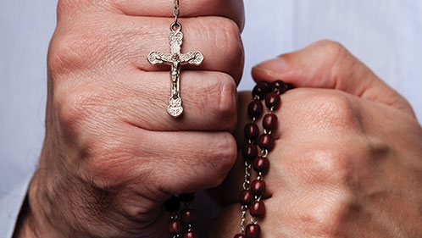
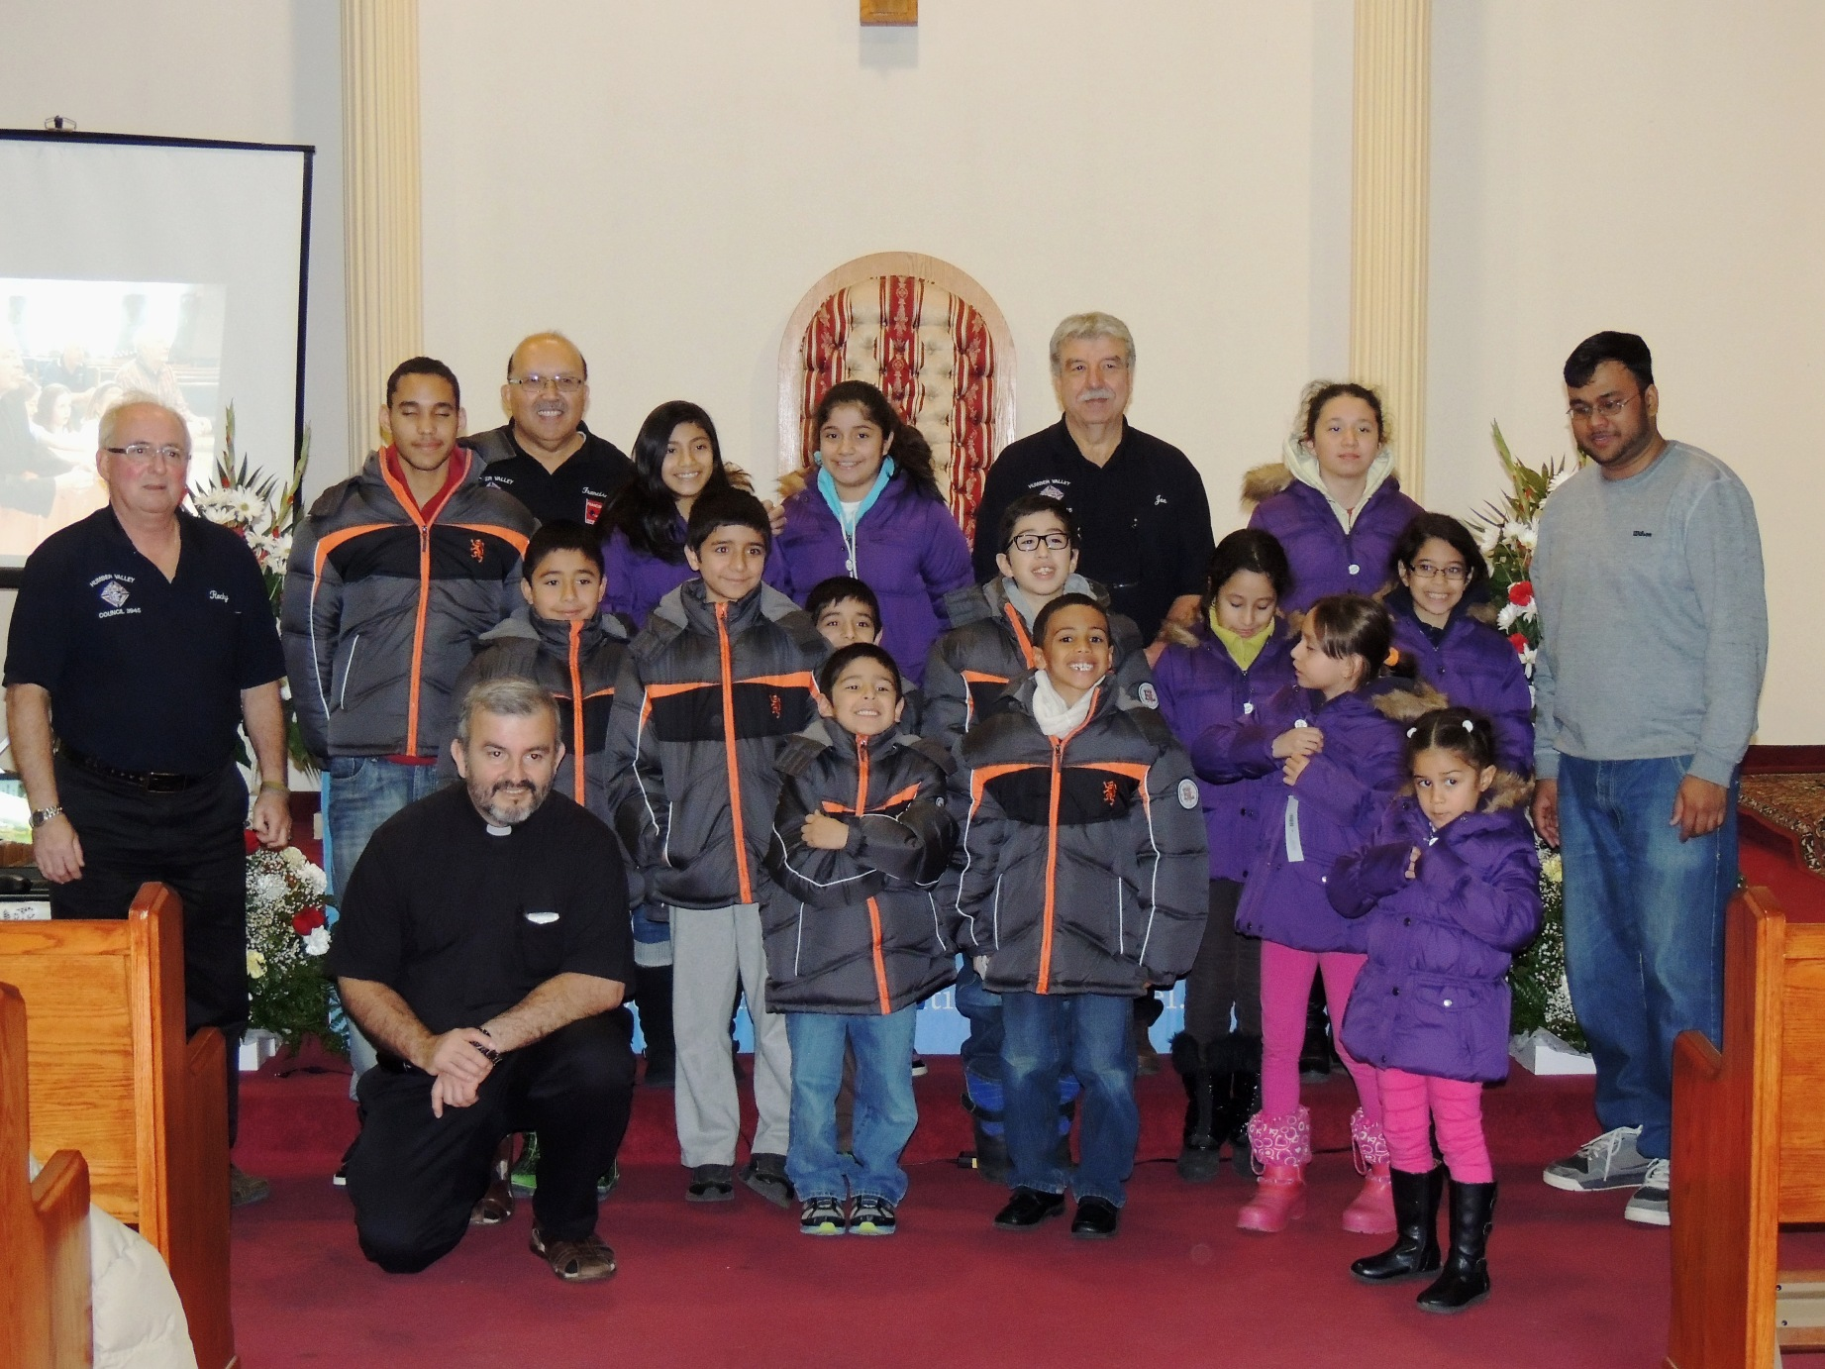
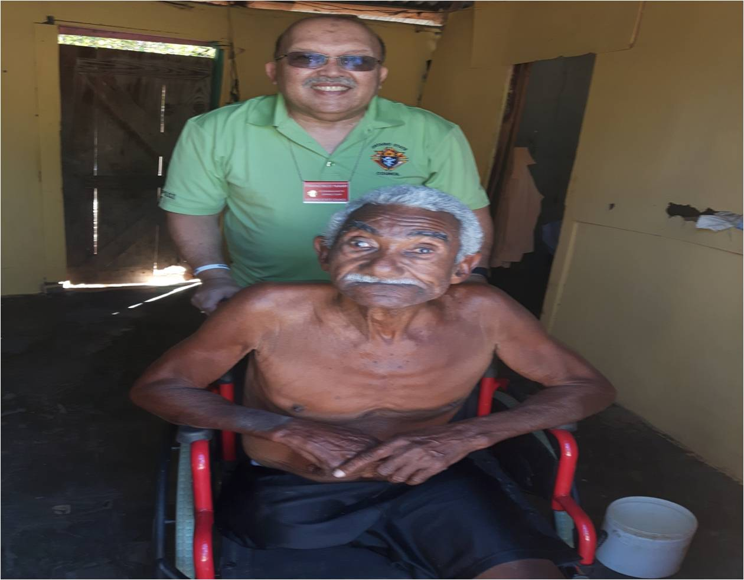
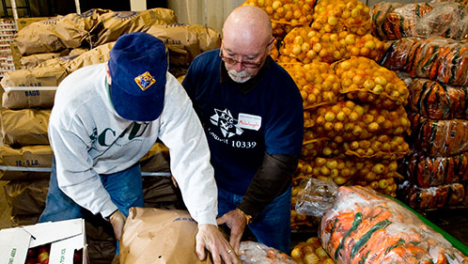
Keep your members interested in
participating in your council activities/programs.
Faith Programs
Community Programs
Coats for Kids
Praying the rosary
Support Vocations (*)
Family Programs
Wheelchairs
Life Programs
Food for Family
Family of the Month
Newly Ordained
Retention
Roses for Life
Ultrasound

Slide 6
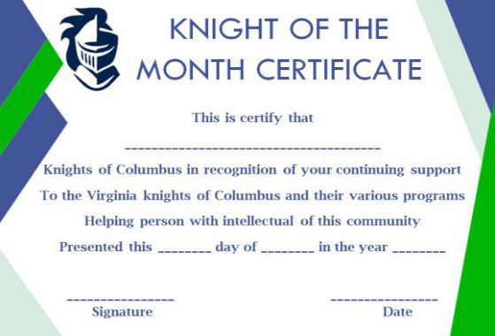
Keeping Membership Personnel Motivated
The membership director and each committee chairman are responsible for keeping the membership personnel motivated. It is natural to appreciate recognition for a job well-done.
Here are some suggestions to keep morale high:
› Be sure that each Knight gets full credit and recognition for his work. An occasional personal written note may mean a great deal to the recipient.
› Make use of current membership campaign awards and incentives.
Listen to the suggestions of your council members and acknowledge good advice. Tell your brother Knight that you appreciate his interest and will consider his idea.
› Be prepared to listen when a member has a question or problem. Guide him, but get him to do most of the thinking. This indicates respect for his judgment, giving him confidence and a feeling of importance.
Member Retention
The task of member retention begins as soon as the Admission (First Degree) Ceremonial is conferred upon a new member. From the start, new members should be encouraged to be active and to participate in the Formation (Second Degree) and Knighthood (Third Degree) Ceremonials.
To inspire both new and current First Degree members, that have been inactive more than one year, to be active in your council,
promote the Shining Armor Award.
To earn the Shining Armor Award, Knights must:
↠ Be involved in at least three council service programs.
↠ Attend at least three business meetings.
↠ Receive their Second and Third Degrees.
↠ Meet with your council’s insurance representative.
↠ Recruit at least one new member.
Retention

Slide 7
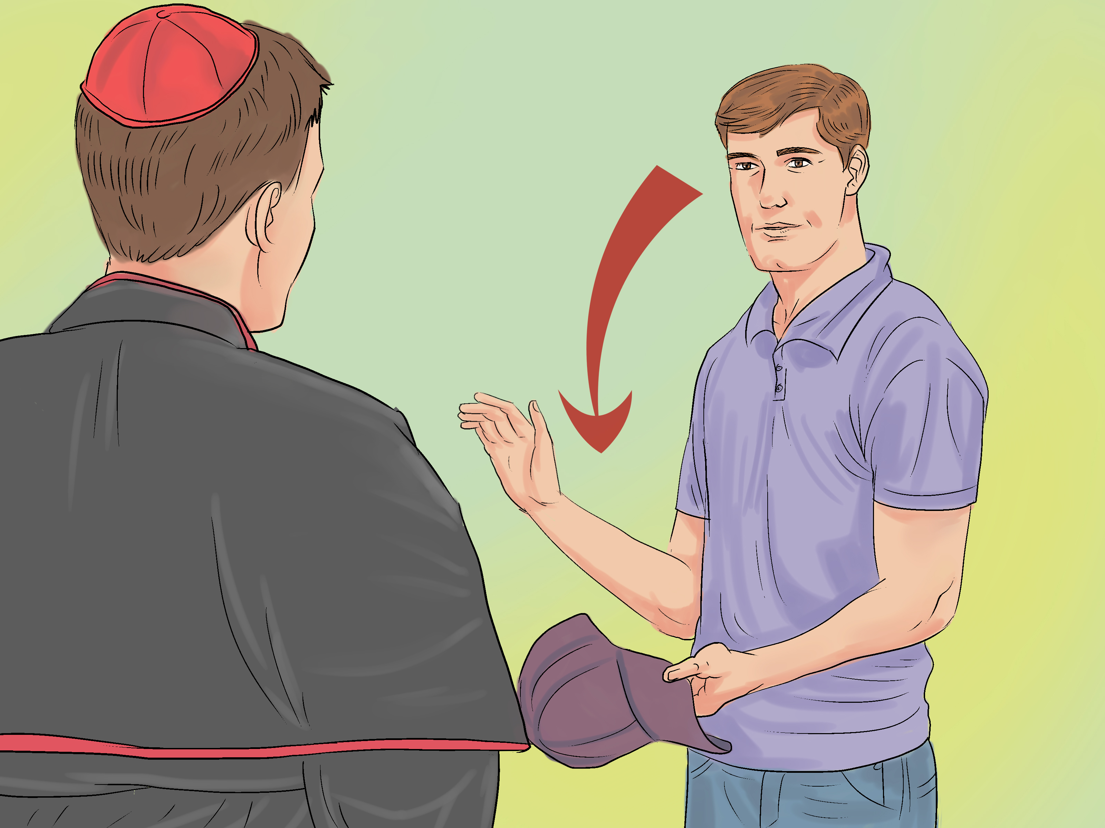
Think of what to say. Before calling, think about some topics that you know interest him. ...
Relax. Once you've planned a few things to say, take a few deep breaths. ...
Find the right greeting. ...
Ask engaging questions. ...
Listen. ...
Answer thoughtfully. ...
Keep the call short
Membership retention is every member’s responsibility. Personal follow-up is the most productive form of retention. If you notice your friend, neighbor or co-worker is not as involved in your council as he once was, a phone call, handwritten note or personal visit is recommended.
Wrong phone or no address
SEARCH SOCIAL MEDIA
FACE BOOK-INSTAGRAM
ASK YOUR PASTOR
VISIT HIM AT HOME
Retention

Slide 8
ONTARIO STATE KNIGHTS OF COLUMBUS RETENTION BILLING PROCEDURES
A vital and important part of the welfare of any Council is the collection of dues and per capita assessments from members.
The Grand Knight and the Trustees should, therefore, always be certain that the following Retention process is followed.
Financial Secretary
Please note that the financial Secretary should be using the Member Management
and Member Billing application, located in the secure Officers Online area of www.kofc.org
Retention

Slide 9
Councils Membership Growth will directly affect suspensions.
Note: For every New Member Recruited, council will be allowed to suspend a member.
This process is to ensure councils longevity and growth.
Financial Secretary: Instructions, recorded webinars, and help are available within the online application.
The Retention Committee should include but not limited to the Retention Chairman (indicated on form 365) the deputy Grand Knight, the Trustees, and the proposer if available.
Note: The Financial Secretary is not part of the Retention Committee.
First Notice
1. The Financial Secretary mails the membership bill “First Notice” 15 days before the billing period
Jan 1 to each member.
2. If payment is not received within 30 days of billing period (Jan1 – Jan 31), the Financial Secretary
will provide a list of delinquent members to the Grand Knight and Retention Committee.
3. 30 days after mailing of the KA1, the Grand Knight will submit form SO 47 and Form SO 48 to the District Deputy for his review, approval or denial. The District Deputy will then forward the SO 47 and SO 48 to the Ontario State Retention Director.
4. Upon receiving the SO 48, the State Retention Director will review the form and supporting documents and return the results of his findings to the District Deputy whether approved or denied submitting of form 1845. 60-day Retention Period.
The State Deputy will mail a letter to each member from the SO 48's assisting the Councils in their retention efforts.
Retention

Slide 10
5. a) If SO 48 is approved the Council is free to submit form 1845 Intent to Suspend, Form 100, and approved SO 48 to Supreme. There will no longer be a 60-day Retention period from the date received by Supreme. (Original copy goes to delinquent member; Supreme office copy is mailed to Membership records, Council copy is retained by the Council). (Allow Approx. 30 days for processing).
b) If SO 48 is denied, the Council must wait until the next billing cycle Dec 15th and entire
billing/retention process must be re implemented as described. Reasons for denial will be provided so
they can be corrected.
6.a) Supreme will then issue a Conservation List to State were the District Deputy will receive a copy
from the Retention Director. Conservation list will be checked by the State Retention Director and
District Deputy to ensure a SO 48 has been submitted for each member.
The Council Retention Chairman will assign a committee member to discuss the reason for non-payment, any personal situations prohibiting payment, or offer a cooperative remedy to the delinquency situation
The Retention Chairman will notify the Grand Knight of the results.
Note: The retention committee must use various methods of contact home visit, internet search to locate, social media, parish. Voice mail does not constitute contact.
If a Member is experiencing financial difficulties, the retention chairman will inform the Grand Knight and Financial Secretary of the council to make accommodations for the members difficulty.
Note: Personal Financial difficulty is not a sufficient reason for suspension and if they experiencing financial difficulties they CAN NOT be suspended.
The Retention Committee is expected to attempt to retain members throughout the entire process.
The District Deputy is Expected to assist the Council throughout the process and attempt to retain members.
Retention

Slide 11
INSURANCE MEMBERS
– GIVE LIST TO FIELD AGENT TO CONTACT
DISABILITY INSURANCE
- MEMBERS WHO ARE DISABILED OR ILL SHOULD BE RECORDED AS SUCH ON-MEMBER MANAGEMENT.
DUES & PER CAPITA ARE WAIVED BY SUPREME & STATE
SUBMIT 1831
DOCTORS NOTE OR REPORT
DISABILITY PAY STUB
Insurance Field Agents should be included in retention process to assist in retaining insurance members.
Members who suffer from a disability or illness should be placed on disability were council dues and per capita is waived by Supreme and State.
The following are documents excepted by Supreme:
a) Form 1831.
b) Doctors note or report detailing disability/illness and stating the member inability work.
c) Disability pension pay stub showing they receive funds from disability.
Retention

Slide 12
Councils should make every effort possible NOT to suspend our elderly members 70+ years of age.
Councils should make every effort possible NOT to suspend members who are within 5 years of Honorary/Honorary Life.
Every Financial Secretary has received clear and concise instructions on this procedure.
It is the duty of the District Deputy to make certain that they are being carried out by the Financial Secretary and Retention committee of each of the councils in his district.
Retention

Slide 13
NEW FORMS
AND
PROCEDURES
Are in your binder
SUPPORTING DOCUMENTATION SHOULD BE FORWARED TO STATE RETENTION DIRECTOR
Francisco Naar
kofcontariofrancisconaar@gmail.com
Retention

Slide 14
Ontario State
Membership Retention Program
2019 - 2020
Presented by.
Francisco Naar
Ontario State Retention Director
kofcontariofrancisconaar@gmail.com
July 6, 2019
Retention

